Slide 1

DEPARTMENT OF COMPUTER SCIENCE
Zuper Market (E-shopping website) Project
Submitted By :
Lalit Giri
1621614825
MCA 6th Sem

Slide 2
INTRODUCTION
“On-Line Shopping System” is a web-based project which is made for remote-shopping or shopping through Internet. As the technology is being advanced the way of life is changing accordance. Now a day’s we can place the order for anything from our home. There is no need to go the shop of the things we want. The order can be placed online through Internet. The payment, the confirmation of purchasing; we can do everything that we want. Now we can think that how the days have been changed with time. People had to stand in rows to wait there terms to buy a particular thing from a popular shop. But what is happening now a day’s; we can extremely surprise that those things can be available on the door-step in few hours. People had to suffer the rush of the market when they went for shopping. They used to think hundred times to buy anything having the sufficient money for shopping.

Slide 3
INTRODUCTION (Cont.)
The problem was the rush; the quarrel at the time of buying the things. But the advancement of technology brought the new way for shopping. The way of shopping was completely changed with the coming of Internet Technology. People have to fill a simple form on the internet to place their order on any popular shop or shopping-mall for the thing they want to buy. Now they can place their order from the home. This project entitled “On-Line Shopping” is an implementation of the above description. It means, it implements the E-shopping or in other word shopping through Internet. It lets the user to place their order online for any article.

Slide 4
OBJECTIVE
Today the internet and its boom have created a new economic scenario that not only stresses on the classical concept of the “product” but also on the modern concept of “service”. It is this level of service that dictates whether a commercial venture will succeed or not in the market. To provide a high accessibility of service we will design the online shopping website, so that potential customers need not go to a physical shop to buy products or services.

Slide 5
OBJECTIVE (cont.)
There are several objective of this websites are following given below:
This site is gives all the information about the e-shopping to provide better service for the customer.
It provides the facility to the customers who want to shop on-line due to lack of time.
It’s providing the full details about the product and related information about the product like cost, size etc.
With the help of it we can save the time and money also.
It provides multiple payment methods for shopping by the cash, Debit card and credit card also.
It provides better security and good delivery service to the customer.

Slide 6
PROJECT-CATEGORY
Web-Based Application Software with RDBMS:
This System i.e. “On-Line Shopping” is a web based application software which perform the activities like Administering, providing information to the shopping by the remote system or through internet. The nature of this software to handle a particular task that’s why it is the category of application software.

Slide 7
PROJECT-CATEGORY (cont.)
This project falls under The Category of Internet Technologies with RDBMS, since the project is mainly for providing on-line shopping of the different items. This project is utilizing Relational Databases as back-end. Having on-line services for the interested user it has great demand in market. As we know that Internet is huge client-server architecture. The client is a web browser, it is requesting a web based data, a file, or whatever, from the sever staying anywhere in the world. Server is nothing the service provider which provides services to the client. It holds almost all the information that client side wants. I have uses .Net framework to develop the software. Asp .Net is rich set programming framework for building web-based application. It offers amazing support to both developer and administrator.

Slide 8
SYSTEM REQUIREMENTS AND SPECIFICATIONS
Once the system analyst have identified the precise user requirements and analyzed these requirements to weed out in consistencies, they proceed to write the document called the Software Requirement Specification (SRS). It is the final output of the requirements analysis and specification phase.
An SRS document should clearly document the following:
=> Functional requirements of the system
=> Non-functional requirements of the system
=> Constraints of the system
A SRS should have characteristics like concise, unambiguous, consistent, complete, well-structured etc.

Slide 9
Software Requirement
Platform : Web Based
Framework : SpringBoot, Hibernate, Angular 4
Front-End : HTML, CSS, BootStrap 4
Back-End Tool(DB) : Postgre Sql
IDE : Visual Studio Code, Spring Tool Suit
Server : Apache Tomcat

Slide 10
REASON FOR OPTING ANGULAR 4, SPRING BOOT AND HIBERNATE FRAMEWOK
Angular 4 is a JavaScript framework for building web applications and apps in JavaScript, html, and TypeScript, which is a superset of JavaScript. Angular provides built-in features for animation, http service, and materials which in turn has features such as auto-complete, navigation, toolbar, menus, etc. The code is written in TypeScript, which compiles to JavaScript and displays the same in the browser.
Spring Boot framework is an open source Java platform that provides comprehensive infrastructure support for developing robust Java applications very easily and very rapidly. Spring help to make the layered architecture of the application that makes the modules of application loosely coupled.

Slide 11
REASON FOR OPTING ANGULAR 4, SPRING BOOT AND HIBERNATE FRAMEWOK
Hibernate is a high-performance Object/Relational persistence and query service, which is licensed under the open source GNU Lesser General Public License (LGPL) and is free to download. Hibernate not only takes care of the mapping from Java classes to database tables (and from Java data types to SQL data types), but also provides data query and retrieval facilities.

Slide 12
WEB SERVICE
A web service is a collection of open protocols and standards used for exchanging data between applications or systems.
Software applications written in various programming languages and running on various platforms can use web services to exchange data over computer networks like the Internet in a manner similar to inter-process communication on a single computer.
Web services based on REST Architecture are known as RESTful Web Services. These web services use HTTP methods to implement the concept of REST architecture.
A RESTful web service usually defines a URI (Uniform Resource Identifier), which is a service that provides resource representation such as JSON and a set of HTTP Methods.

Slide 13
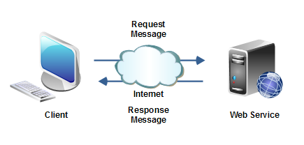
WEB SERVICE

Slide 14
SYSTEM ANALYSIS

Slide 15
Problem Definition
The e-shopping Administrator is the super user and has complete control over all the activities that can be performed. The application notifies the administrator of all shop creation requests, and the administrator can then approve or reject them. The administrator also manages the list of available product categories. The administrator can also view and delete entries in the guestbook.

Slide 16
Employees
Purchase department under a Purchase manager to overlook purchasing activities if warehousing needs arise. Sales department under a Sales manager who will look after the sale of products and services, the most important activity. Accounts department under an Accounts manager to look after the accounting activities of the enterprise.

Slide 17
Requirement Specification
It is quite difficult and time consuming task to find the information as well as maintaining information manually. If all these information are to be kept at a single place it is also not possible in the manual system. Computerized system will upgrade and manage information very easily. As it is a web-based application so it uses Internet technologies and its hardware/software requirement will also be more comprehensive than Desktop application system. Some Network devices will be required like modems, switches, Internet connection. Software required for the system is also different from a normal desktop system. First of all a server software will be mandatory (here Internet Information Server (IIS)). A browser is also needed as a client process on the user side.

Slide 18
Preliminary Investigation
System Analysis is not only time consuming but also a rigorous task. But it is crucial and most important phase of Software development process. Preliminary Investigation is the process of gathering data for requirement analysis. It is more helpful for problem definition and requirement specification.

Slide 19
MODULE DESCRIPTION
We know that it is quite difficult to do anything of its whole part at a time. So it is the task of the programmer to break/split the whole set of task into various small module so that one can handle them effectively. But it depends upon the software system that in which Extent it will be broken so that there is no inter-dependency among them.
This project developed for “On-Line Shopping” is broken into following module.
1. Admin/Vendor Module 2. User Module
3. Payment Module 4.Purchase Module
5. Searching Module 6. Report Module
7. Customer Service Module

Slide 20
PROCESS LOGIC
Process logic is concerned with how the system interact with users and fulfill there requirements? Being a web based system; user of this system can easily access this system through Internet. It provides various functionalities, attracts the user to use it, and makes the user comfortable to work on it.
Before providing access to the manipulating authorities, it first demands for user name and password based on user type. If the name and password entered are correct then one can enter the admin menu and can change any contents from this place.
It also works as a public website where one can see the information based on the purpose to access this website. There is no need for authentication here, because they has to only access the site not change or update any content and they also cannot change it because they have no authority to change.

Slide 21
DATA FLOW DIAGRAM

Slide 22
Index Page
Category Page
Cart Page
Category
Category 1
Category 2
Category 3
Category 4
Product
Product 1
Product 2
Product 3
Product 4
Add To Cart
Cart Items
Item 1
Item 2
Item 3
Item 4
Clear Cart
View Cart
Proceed To Checkout
Continue Shopping
Online Shopping System Process WorkFlow
Confirmation Page
CheckOut Page
Purchase Confiramation Details
Purchase Calculations
Enter Personal Details
Submit Purchase

Slide 23
Product Management
Vendor Management
Admin/ Vendor
E-commerce Portal Management
Admin / vendors
User Management
Users/ Customers
Users /
Customers
Cart Management
Place Order
DFD
Level 0
User Details Management
Database
View Product

Slide 24
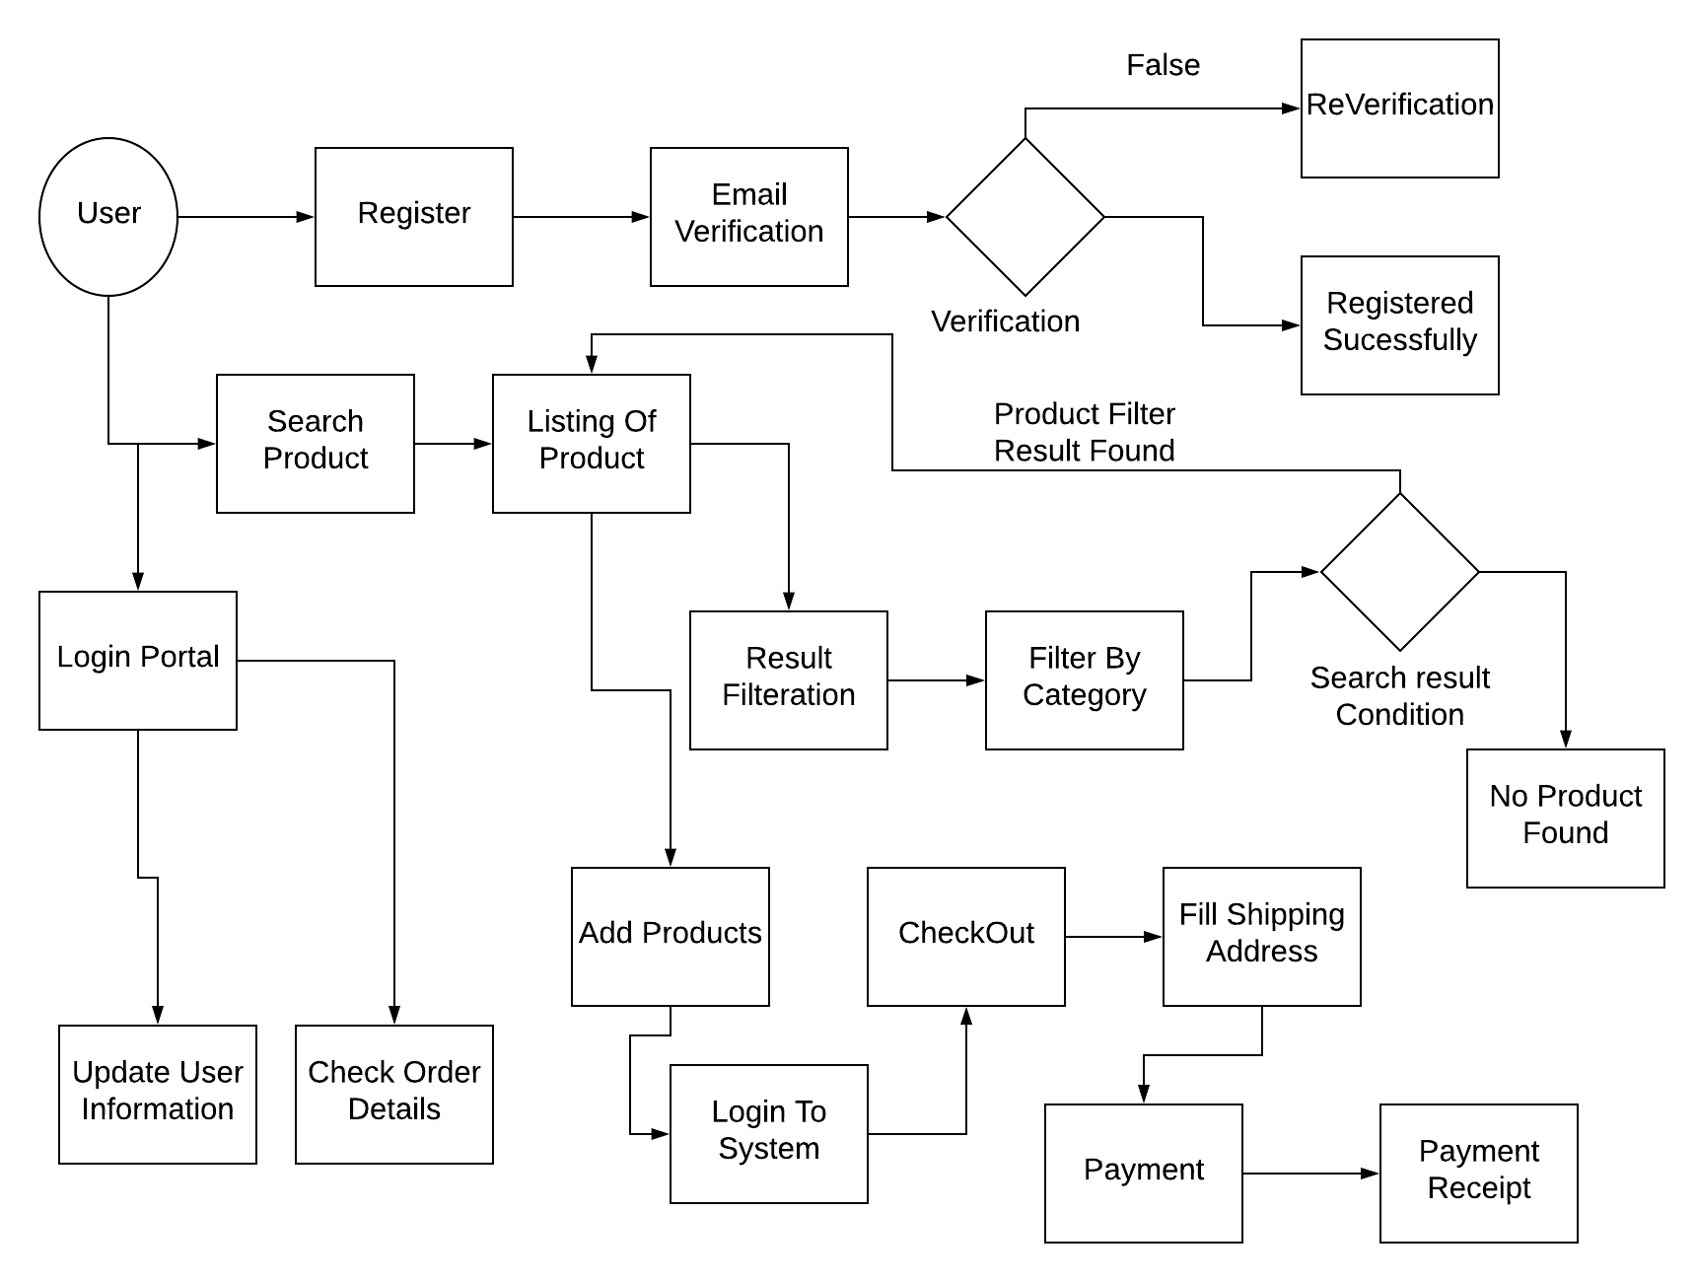
User DFD
Level 1

Slide 25
ENTITY RELATIONSHIP DIAGRAM

Slide 26
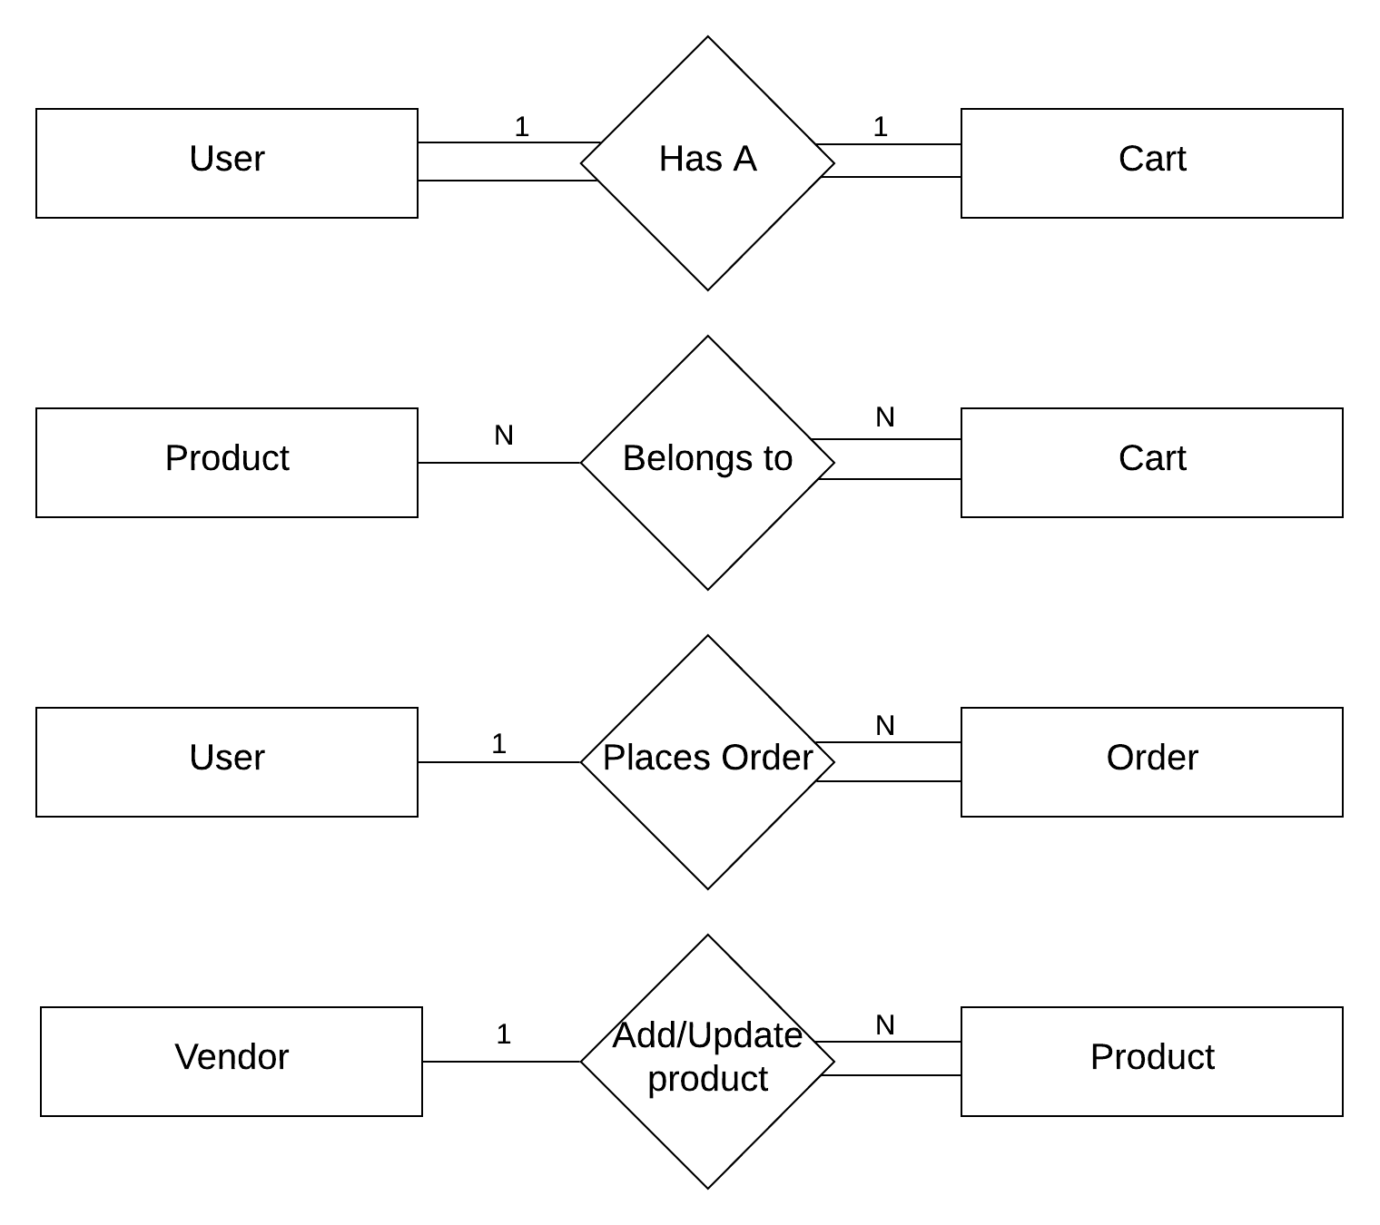
Relation-Ship
Between Entities

Slide 27
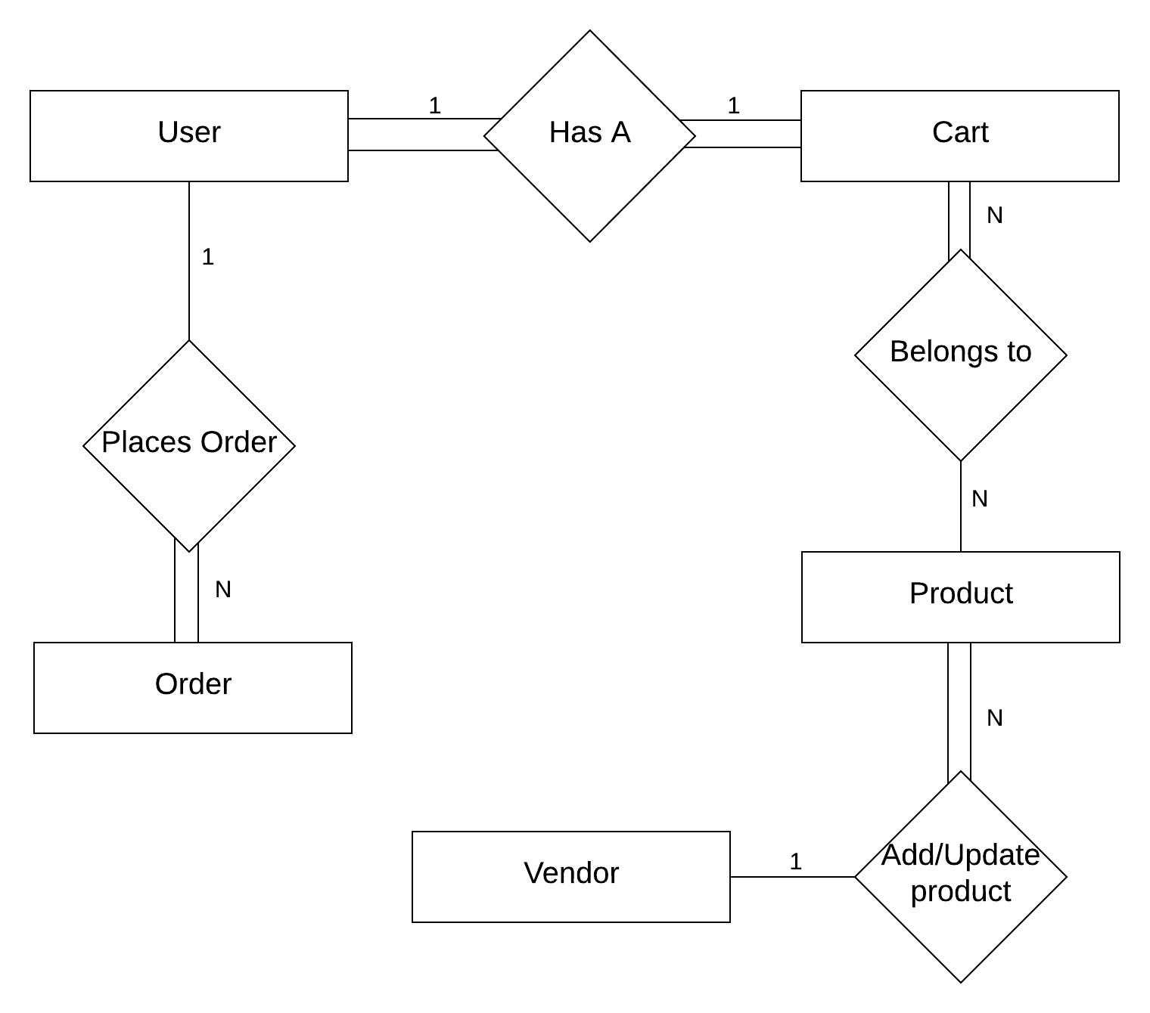
Complete Structure of
Relation-Ship
Between Entities

Slide 28
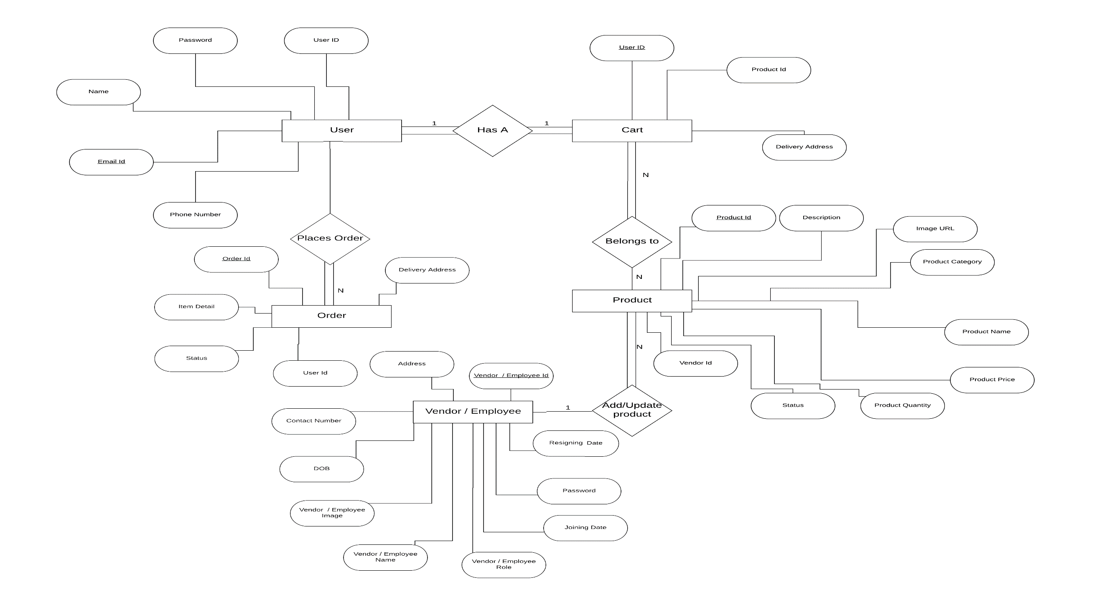
ER DIAGRAM

Slide 29
SCREENSHOTS

Slide 30
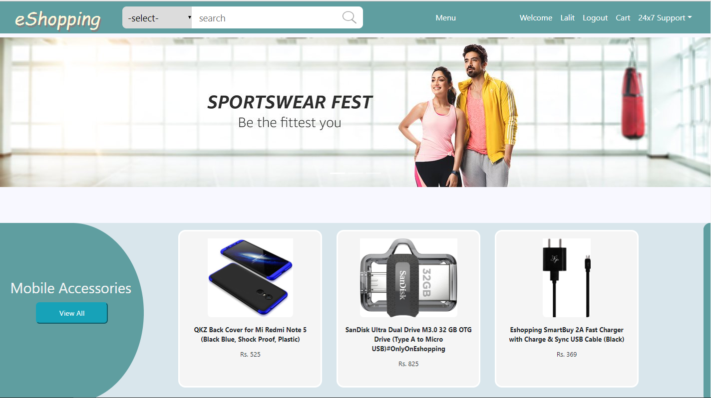
Index Page

Slide 31
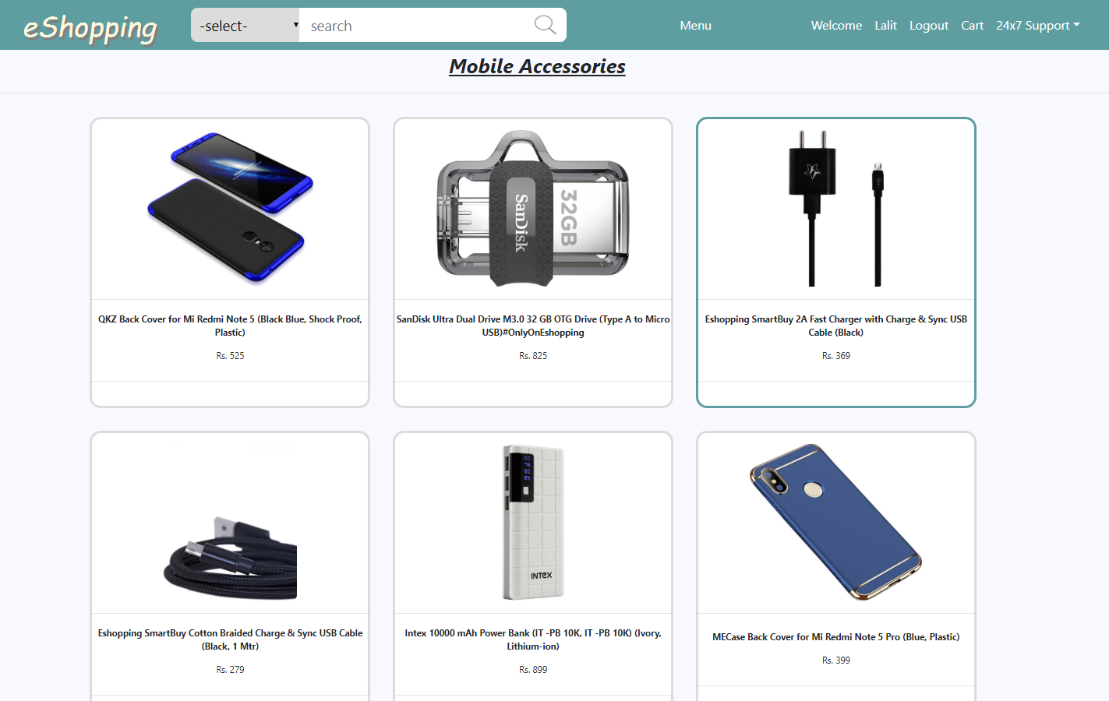
Category-Mobile Accessories

Slide 32
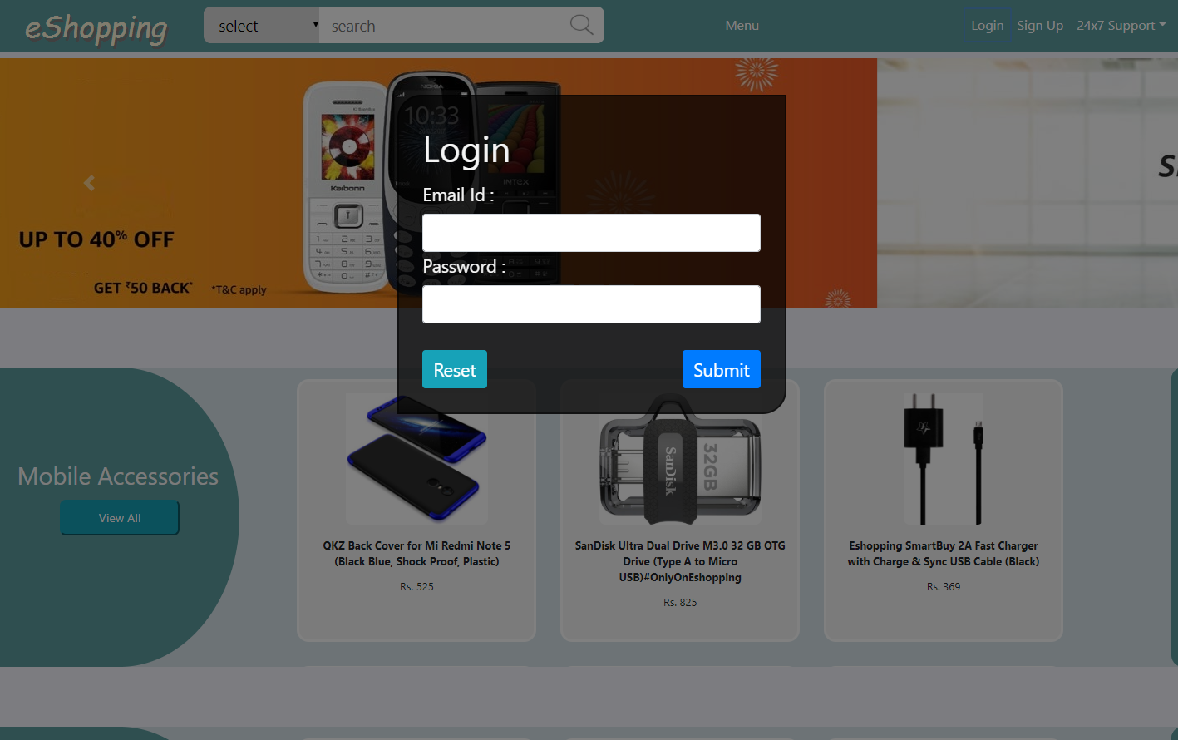
Login

Slide 33
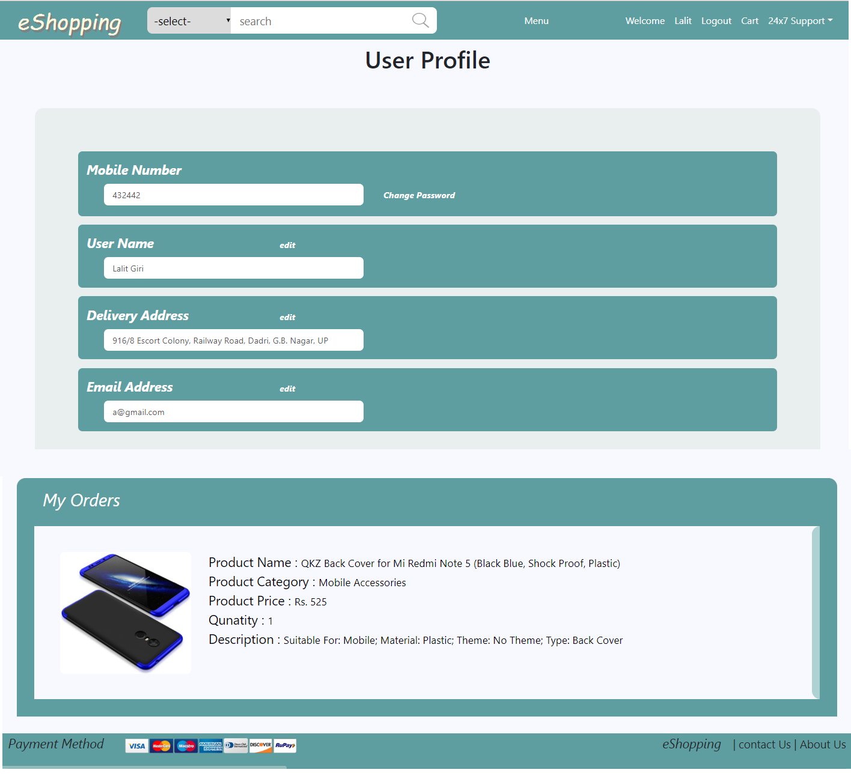
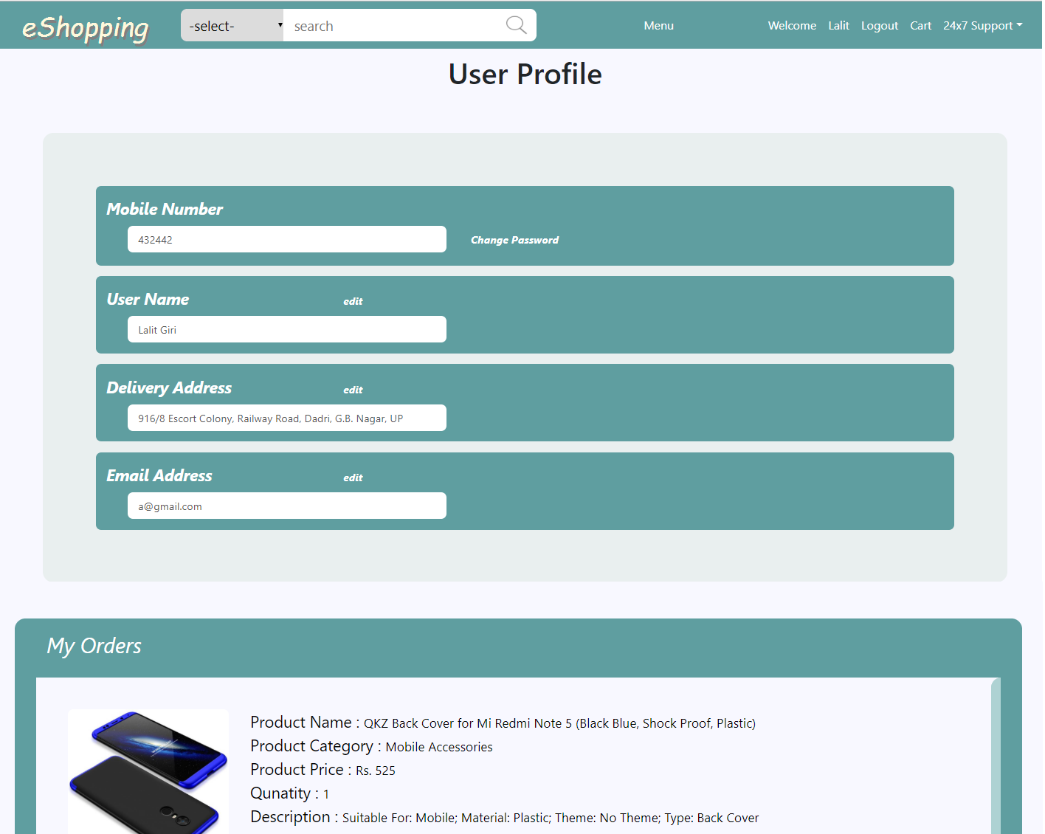
User Profile

Slide 34
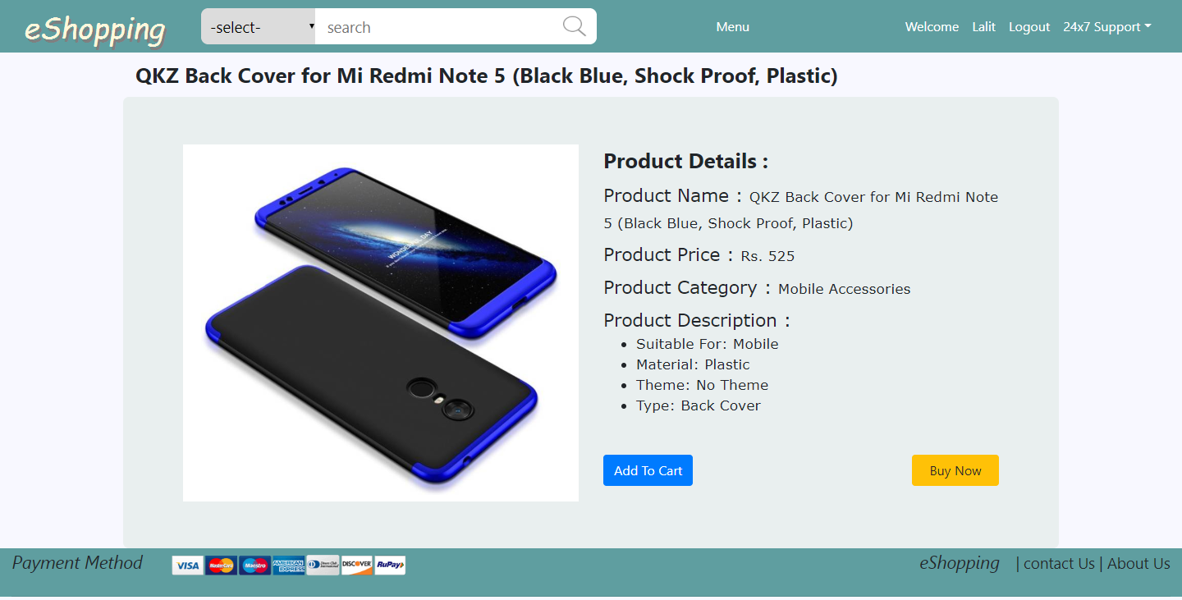
Product
Description

Slide 35
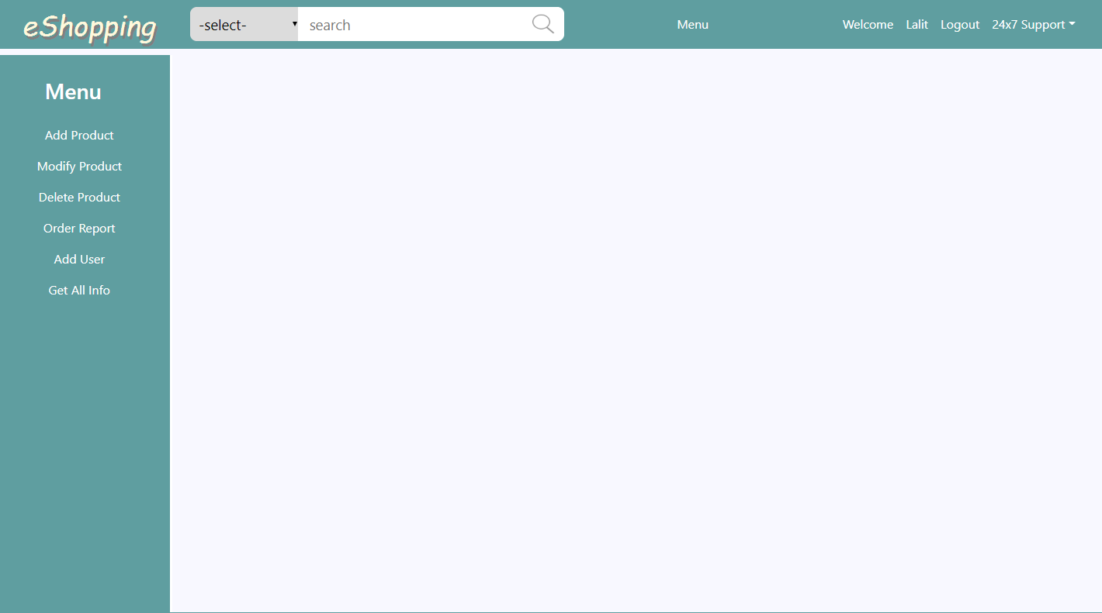
Admin
Module

Slide 36
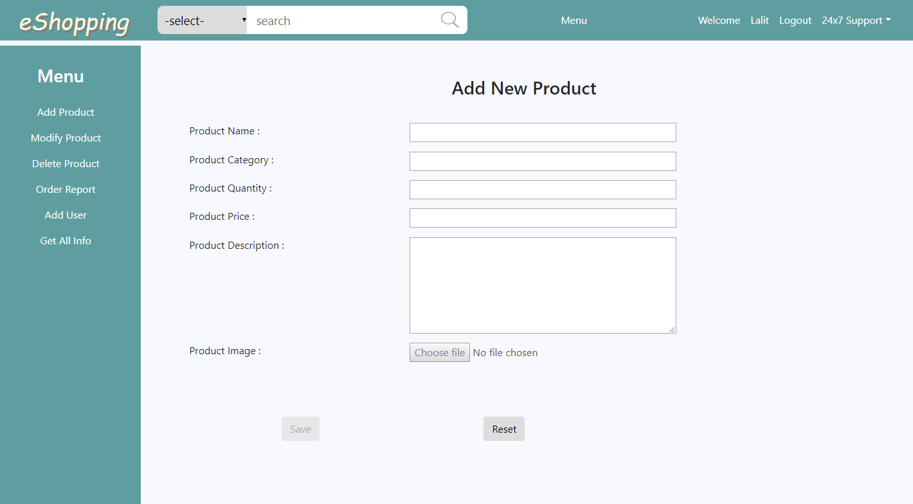
Add Product

Slide 37
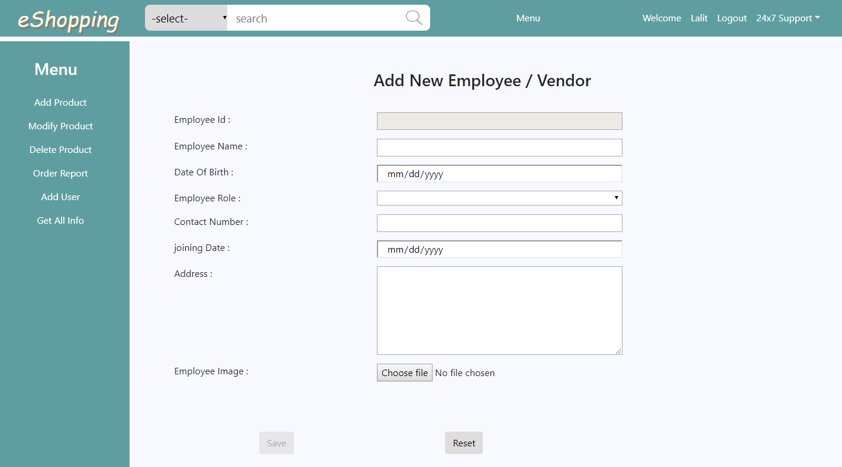
Add
Vendor/ Employee

Slide 38
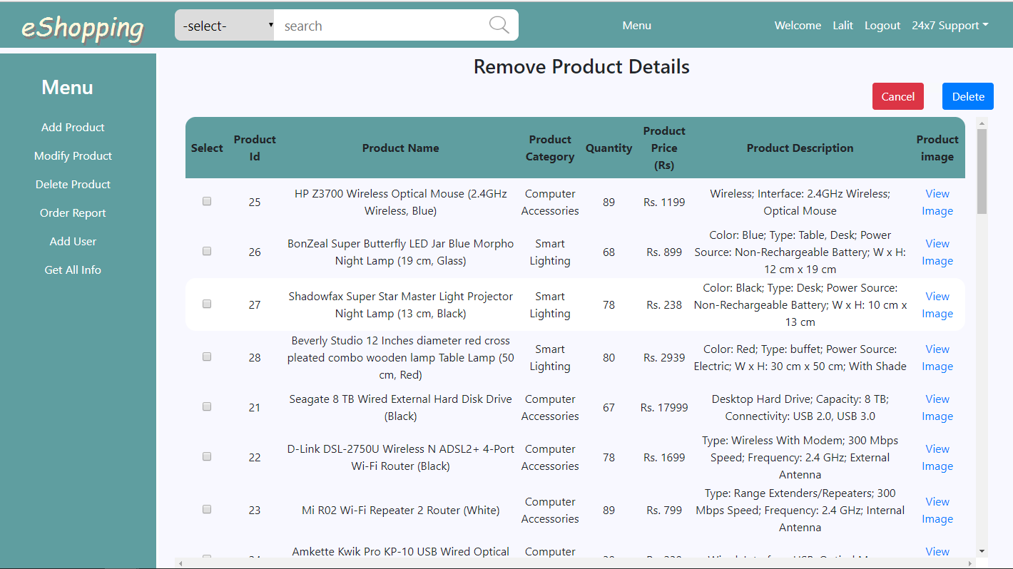
Remove Product

Slide 39
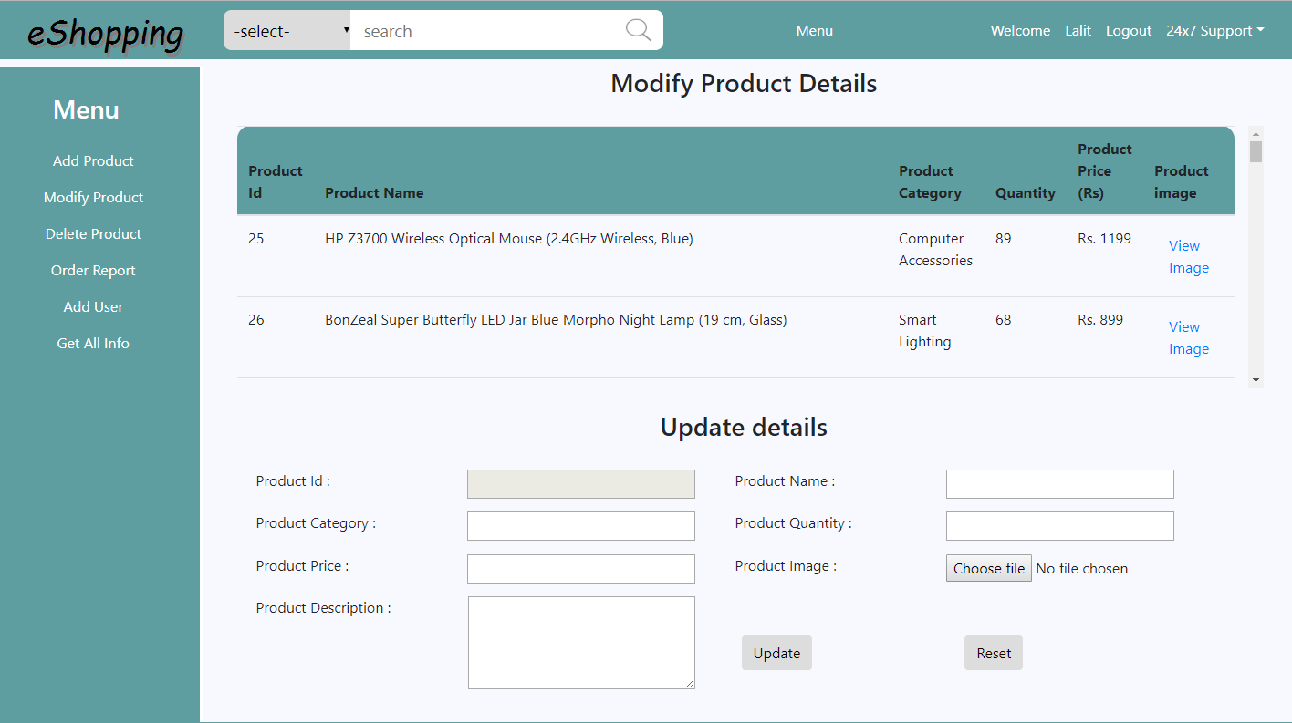
Update Product

Slide 40
FUTURE SCOPE OF THE PROJECT
“On-Line Shopping” is a web-based project which is made for remote-shopping or shopping through Internet.
As the technology is being advanced the way of life is changing accordance. Now a day’s we can place the order for anything from our home. There is no need to go the shop of the things we want.
The order can be placed online through Internet. The payment, the confirmation of purchasing; we can do everything we want.
In future we will try to make this website which work so flexible and beneficial for the customer and also try to make smooth service.

Slide 41
Thank You

